Slide 1
Jordan’s Fertilizer Industry
NJFC as a Case Study
ENG. MUSLEH ABU OBAID

Slide 2
Table of Content
What is fertilizer
Main types of fertilizer
Classification of fertilizer
NPK Fertilizer
Jordan’s Fertilizer industry
Jordan, A Leading Global Fertilizer Supplier
Jordan’s Integrated Fertilizer Varieties
Nippon Jordan Fertilizer Company
Company Overview
Plant Capacity & Production Rate
Process Description
Main units in the process:
NJFC Products
Comparison between Chemical Granulation vs Bulk Blending
NJFC Awards, Certificates & Recognitions
Opportunities for Jordan’s Fertilizer Industry

Slide 3
What is fertilizer
Any natural or synthetic material applied to soil or plant tissues to supply one or more essential nutrients that enhance plant growth and yield
Primary macronutrients supplied: Nitrogen (N), Phosphorus (P), Potassium (K).
Secondary macronutrients (Ca, Mg, S)
micronutrients (Fe, Zn, B, Cu, Mn, Mo, Cl)

Slide 4
Main types of fertilizer:
Nitrogen Fertilizers
Ammonia ,Urea, Ammonium Nitrate, CAN, UAN solutions.
• Feedstock: natural gas (H₂) + air (N₂) via Haber‑Bosch.
• Provides readily available N for chlorophyll and protein synthesis.
Phosphorus Fertilizers
Diammonium Phosphate (DAP), Mono‑ammonium Phosphate (MAP), Triple Superphosphate (TSP), Single Superphosphate (SSP).
• Raw materials: phosphate rock + sulfuric or phosphoric acid.
• Essential for root development, energy transfer.
Potassium Fertilizers
• Muriate of Potash (MOP, KCl) ~60 % K₂O, Sulfate of Potash (SOP, K₂SO₄).
• Raw material: potash ores (carnallite, sylvinite) or solar‑evaporated brines.
• Enhances water regulation, enzyme activation, disease resistance.

Slide 5
Classification of fertilizer
Main Fertilizer Classifications :
By origin:
Inorganic (synthetic / mineral)
Organic (plant‑ or animal‑derived)
By nutrient spectrum
Straight (single‑nutrient) fertilizers
Compound / NPK (multi‑nutrient) fertilizers
Specialty (controlled‑release, water‑soluble, foliar, micronutrient, etc.)

Slide 6


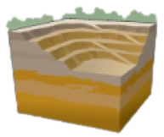







Raw Materials
Natural Gas
Sulfur
Phosphate Rock
Chlorine / Hydrogen Gas
Potash Source
Ammonia Plant
Sulfuric Acid Plant
Rock Grinding Plant
Hydrochloric Acid Plant
Plants
Nitric Acid Plant
Phosphoric Acid Plant
Potassium Chloride Plant
Ammonium Nitrate Plant
Ammonium
Sulfate Plant
Phosphoric Acid
Purification Plant
Phosphoric
Acid Plant
Di-Calcium
Phosphate Plant
Potassium
Phosphate Plant
Conversion
Plant
Potassium
Nitrate Plant
Formulas
Ammonium
Nitrate
Ammonium
Sulfate
NPs
Granules
Urea
SSP / TSP
DAP / MAP
NPK
Phosphoric
Acid Tech/Food
Calcium
Chloride
DCP
MKP
Potassium
Chloride
Potassium
Sulfate
Potassium
Nitrate
Tech.MAP
N J F C

Slide 7
NPK Fertilizer
NPK fertilizers are compound fertilizers that contain three essential macronutrients.
Compound (NPK) Fertilizers
• Each granule contains N, P and K in a fixed ratio (e.g., 15‑15‑15).
• Produced by chemical granulation, melt granulation, or steam/pipe reactor routes.
• Allows balanced nutrition and uniform nutrient distribution to every plant
Main Raw Materials in Fertilizer Production
• Ammonia (from natural gas or renewable H₂)
• Phosphoric & sulfuric acid (from phosphate rock & sulfur)
• Potash (KCl, K₂SO₄)

Slide 8
Key Advantages of NPK Fertilizer vs. Straight Fertilizers
Uniform Nutrient Supply
• All nutrients in every granule → consistent field distribution
Better Crop Performance
• Balanced nutrition → higher yields & efficient nutrient uptake
Lower Application & Transport Costs
• Fewer field passes & simplified logistics
Simplified Retail & Inventory
• Fewer product types to stock and organize → easier handling, stocking, and sales

Slide 9
Jordan, A Leading Global Fertilizer Supplier
The fertilizer industry has become one of the most important pillars of Jordan’s economy, supported by several key factors:
Abundant Phosphate Resources: Jordan has large reserves of high-grade phosphate rock, which serve as a vital raw material for fertilizer production.
Continuous Expansion and Investment: With strong national support, ongoing investments have significantly increased production capacity and expanded the product range.
Strong International Relations:
A) Free trade agreements provide Jordan with access to major global markets.
B) International cooperation has encouraged foreign investment, joint ventures, and infrastructure development.
C) Public-private partnerships help strengthen the sector.
Advancements in Technology and Quality: Collaborating with international partners has improved technical expertise, upgraded quality control systems, and introduced more sustainable production technologies.

Slide 10
Strategic Location for Global Trade: The Port of Aqaba offers direct access to key markets in Asia, Africa, and Europe, making Jordan a major export hub.
Global Collaborations: Joint projects with countries like India, Japan, and several Arab nations bring in advanced technology, funding, and new market opportunities.
Jordan Offers a wide Range of Fertilizer Products — From Raw Materials to Finished Goods

Slide 11
Jordan’s Integrated Fertilizer Varieties
Jordan Offers a wide Range of Fertilizer Products — From Raw Materials to Finished Goods
1. Raw Materials
Phosphate Rock
– Mined by Jordan Phosphate Mines Company (JPMC)
Potash (Potassium Salts)
– Extracted by Arab Potash Company (APC)

Slide 12
Jordan’s Integrated Fertilizer Varieties
2. Intermediate Products
Phosphoric Acid
Processed from phosphate rock, used in many phosphate-based fertilizers
Produced by JPMC group(Aqaba complex, IJC, JIFFCO)
Sulfuric Acid
Processed from Sulfur element, used in many phosphate-based fertilizers
Produced by JPMC group(Aqaba complex, IJC, JIFFCO)
Nitric Acid
Processed from Ammonia, Used in many fertilizers.
Produced by APC group (Kemapco)

Slide 13
3. Final Fertilizer Products
A. Straight Fertilizers
Phosphoric Acid (for industrial/agricultural use)
Produced by JPMC group(Aqaba complex, IJC, JIFFCO)
B. Compound Fertilizers
DAP (Di-Ammonium Phosphate)
Produced by JPMC group (Aqaba complex, NJFC)
MAP(Mono Ammonium Phosphate)
Produced by JPMC group (NJFC)
NP/NPK Fertilizers – Customized nutrient formula
Produced by JPMC group (NJFC)
Potassium Nitrate
Produced by APC group (Kemapco)

Slide 14
C. Specialty Fertilizers
Water-Soluble Fertilizers
Micronutrient-Enriched Blends
Produced by many local plants.
In addition, JPMC Group (Phosphatia) plans to produce DCP/MCP(plant is under construction), a key feed additive essential for the poultry industry

Slide 15
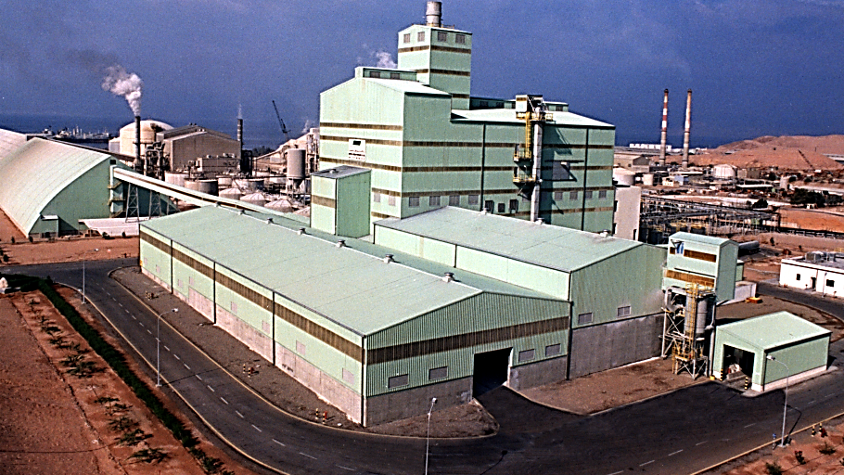

NIPPON JORDAN FERTILIZER CO. W.L.L
شركة الأسمدة اليابانية الأردنية ذ.م.م

Slide 16
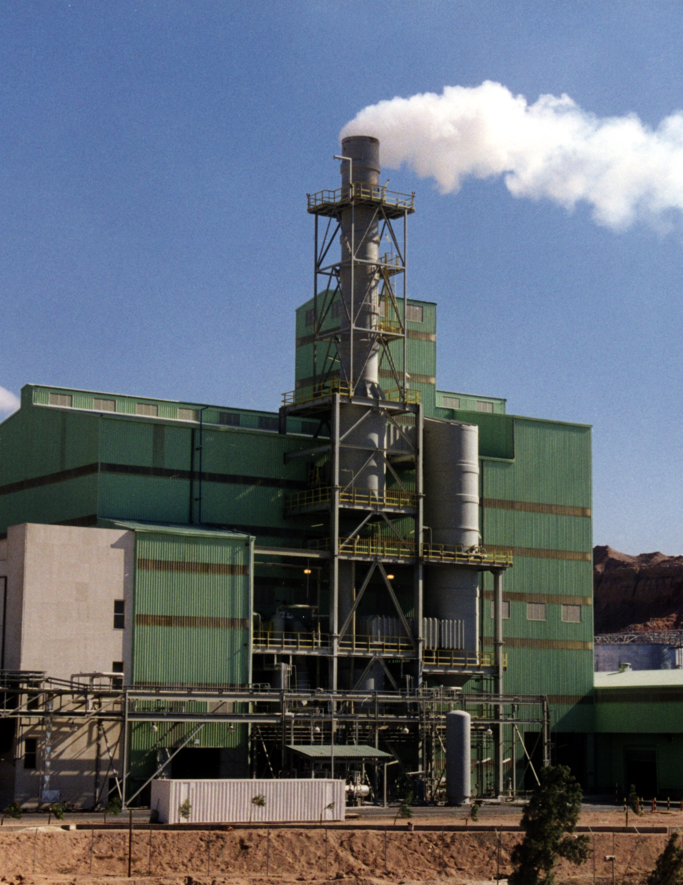
Company Overview
Nippon Jordan Fertilizer company (W.L.L), (NJFC ) is a limited liability company located in the Free Zone of Aqaba. It was established in 1992 as a joint venture project between Japan and Jordan (Four Japanese shareholders and Two Jordanian shareholders ).
Four Japanese shareholders are: (National Federation of Agricultural Co-operative Associations (Zen-Noh), Asahi Industries, Mitsubishi Chemical Corporation, and Mitsubishi Corporation) holding an aggregate 60% stake.
Two Jordanian shareholders are: (JPMC and APC) holding the remaining 40% stake.
The Total Investment was 85 Million US$ , and capital cost was 24 Million US$.
NJFC Plant production had been started in 1997 as well as Sales to Japan had been started also.

Slide 17
Current share in NJFC:
Company Name | Share Percentage
Jordan Phosphate Mines Company (JPMC) | 80%
Arab Potash Company (APC) | 20%

Slide 18
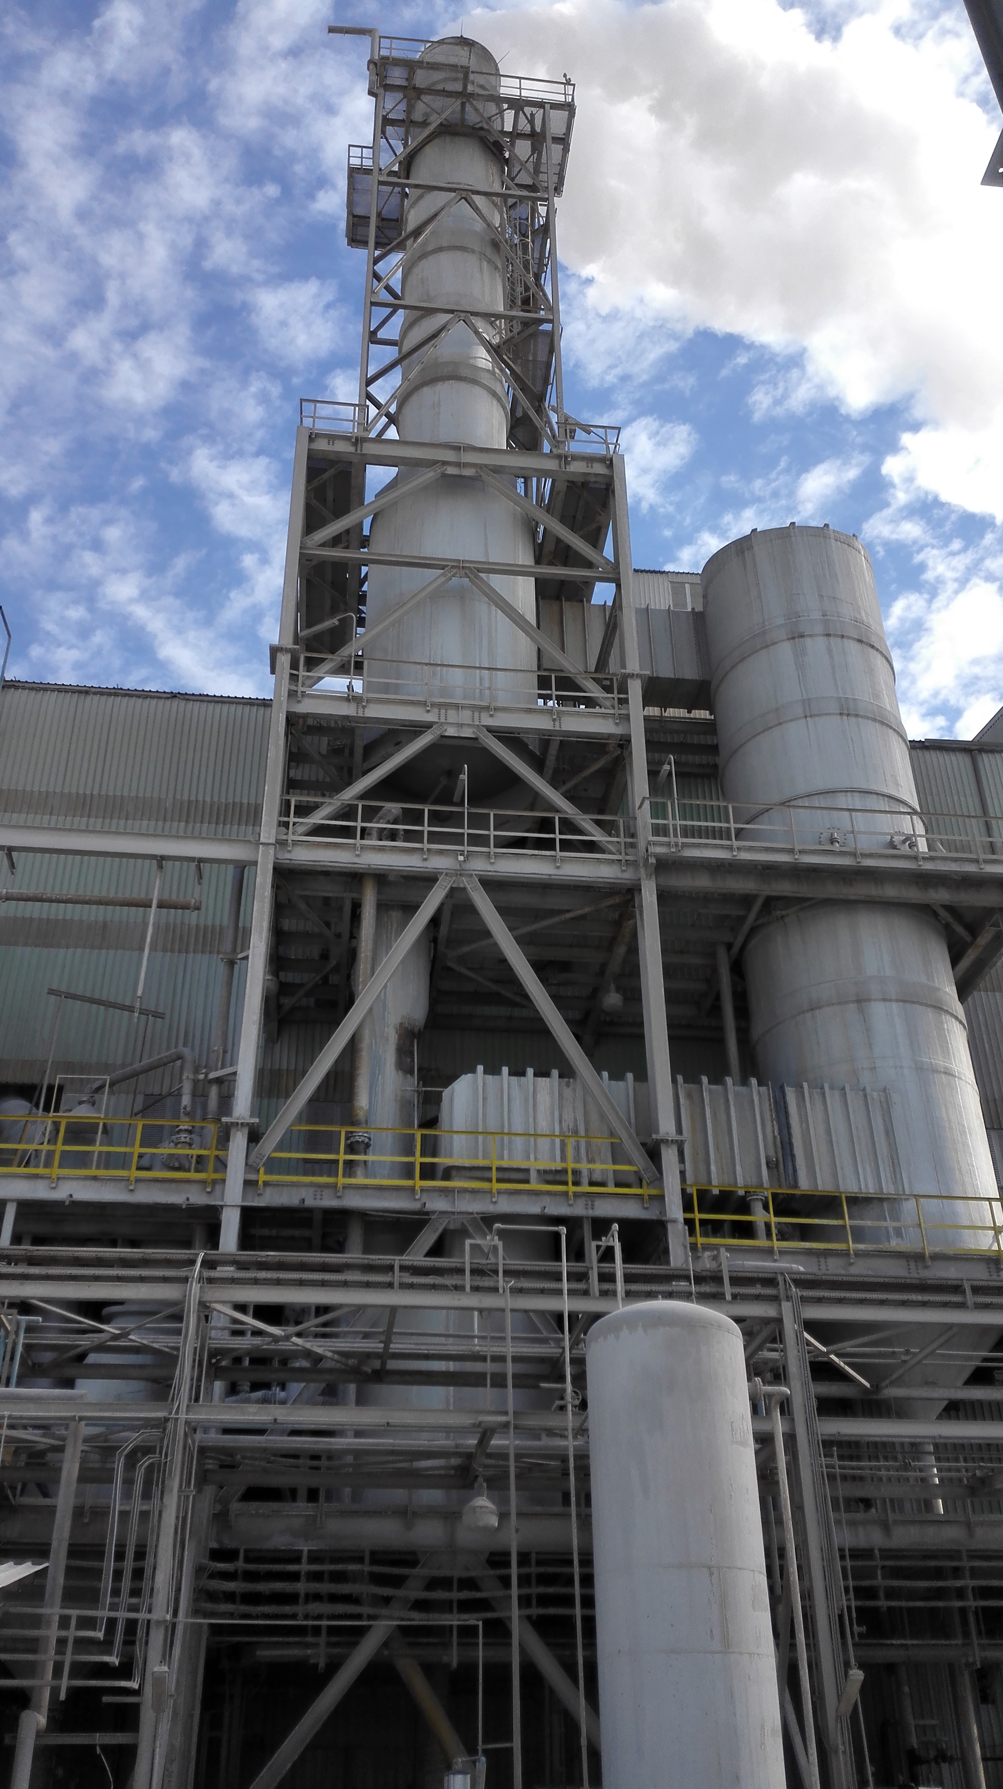
Plant Capacity & Production Rate
NJFC Plant had been designed to produce both DAP& 5 NPK Fertilizer products of annual production rate of about 300,000 MT using the best technology.
NJFC Plant had been designed to produce high quality fertilizers to be exported to the Japanese market.
Nowadays NJFC Plant produces wide range of chemical compound fertilizers DAP, MAP, NP and different grades of NPK fertilizers.
Nowadays NJFC produce 32 different grades and export its product to 21 different markets worldwide.
Main markets for NJFC are: Japan, Australia, Ukraine, Iraq and Algeria.

Slide 19
Process Description
The process principle is to neutralize phosphoric and sulfuric acids with liquid ammonia in the pipe reactor and afterwards to granulate the neutralized product.
With the same pipe reactor and equipments , it is possible to produce DAP,MAP,NPS and NPK grades .
Main Raw Materials:
Liquid Ammonia
Phosphoric Acid
Sulfuric Acid
MOP ( Muriate of Potash )

Slide 20
Main units in the process:
Pipe Reactor
Rotary Drum Granulator
Rotary Drum Dryer
Screens
Crushers
Fluidized bed cooler
Rotary drum coater
Gas treatment units:
Dry gas treatment: cyclones, bag filters to recover dust
Wet scrubbing system: Venturies and cyclonic column to recover Ammonia and dust

Slide 21
from APC
Gas Scrubber
S-acid, P-acid
MOP
from JPMC
Granulator
S-acid
GPR
Dryer
Screen
Cooler
Coater
Screen
※
Ammonia
Dust Cyclones
Crusher
P-acid
P
※
Product Storage

Slide 22
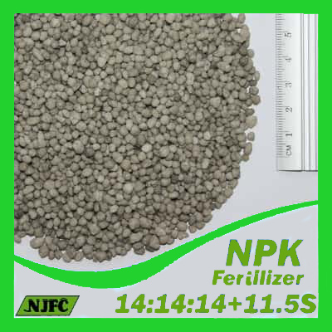
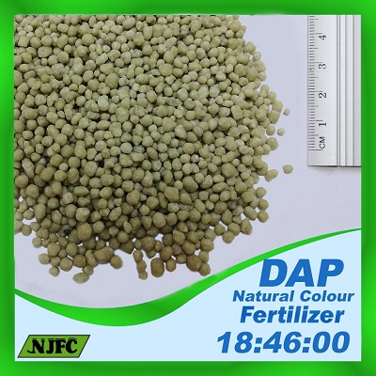
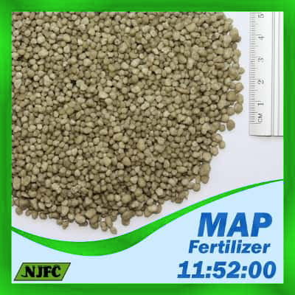
NJFC Products:
DAP 18-46-00
MAP 11-52-00
MAP 12-52-00
MAP 10-50-00
MAP 10-48-00+4Mn
NPS 12-46-00+5S
NPS 20-20-00+13S
NPS 16-20-00+13S
NPS 19-38-00+6S
NPS 10-40-00+5S
NPS 11-40-00+5S
NPS 12-40-00+5S
NPS 13-40-00+7S
NP 11-44-00
NPK 14-14-14+11.5S
NPK 16-16-8+13S
NPK 15-15-15+10S
NPK 12-30-12
NPK 10-26-26
NPK 8-19-28+4S
NPK 10-28-15+5S
NPK 8-16-30
NPK 14-18-14
NPK 9-24-13+3MgO
NPK 8-19-29+4S
NPK 10-20-20+7S
NPK 10-20-10+6S
NPK 12-32-8

Slide 23
Comparison between Chemical Granulation vs Bulk Blending
 | Chemical Granulation | Bulk Blending
Nutrient Distribution | Uniform – each granule delivers the complete NPK ratio | Uneven – mix of different particle types and sizes
Segregation Risk | Very low – uniform granules reduce separation | High – components may separate during transport or application
Physical Strength | Strong granules – better crush resistance and less dust | Variable – depends on the weakest ingredient
Capital Investment | Requires more investment – higher CAPEX and OPEX | Lower investment – cost-effective and adaptable

Slide 24
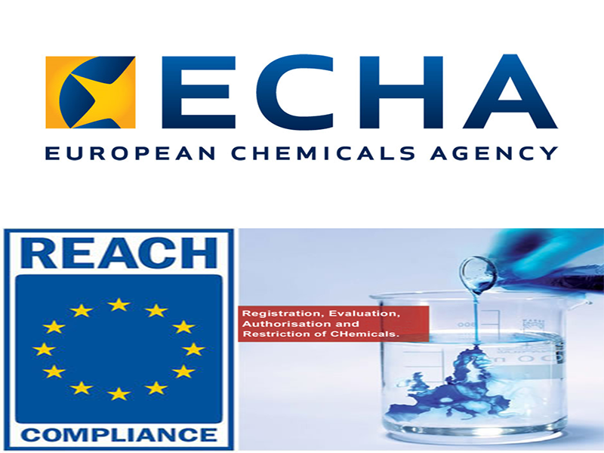
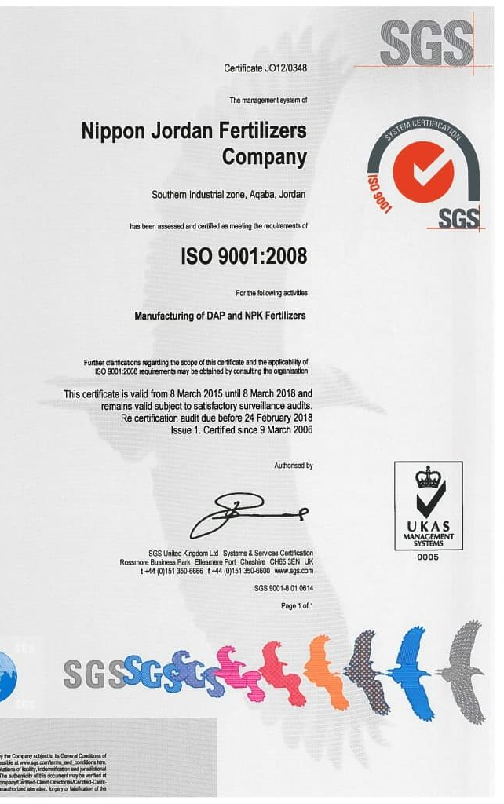
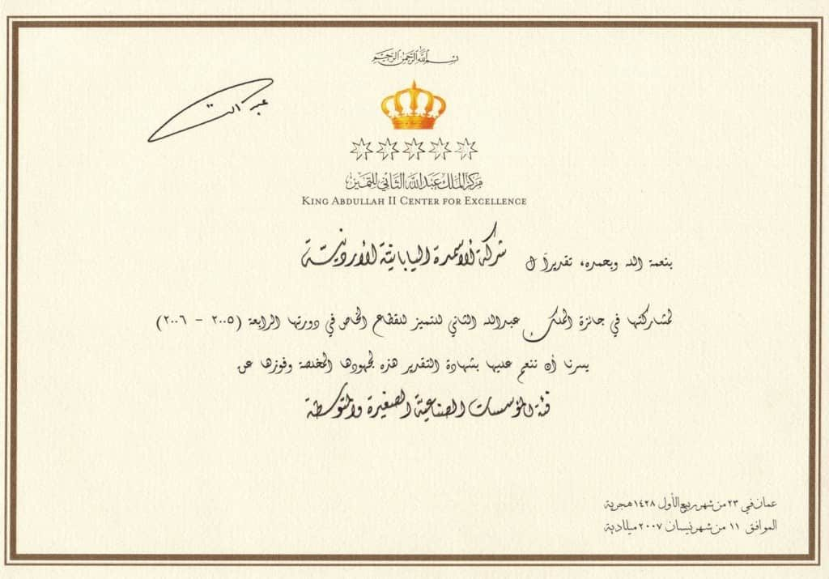
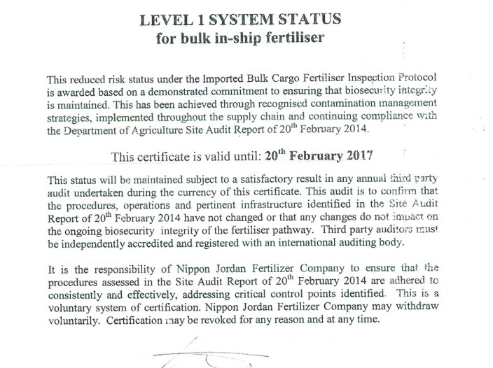
NJFC Awards, Certificates & Recognitions
The “King Abdullah II Award for Excellence” for cycle IV (2005- 2006 )
“The Prestigious Honor Award for Excellence and Development” by His Royal Highness Prince Faisal Ben Al-Husein in 2003.
“ Excellence Award in Safety and Occupational Health” by Social Security Corporation in 2003 and 2022.
“Quality Management System Certification ISO 9001:2000” by SGS.
“Environmental Management System Certification ISO 14001:2015” by SGS
“Occupational Health and Safety Management System Certification ISO 45001:2000” by SGS

Slide 25
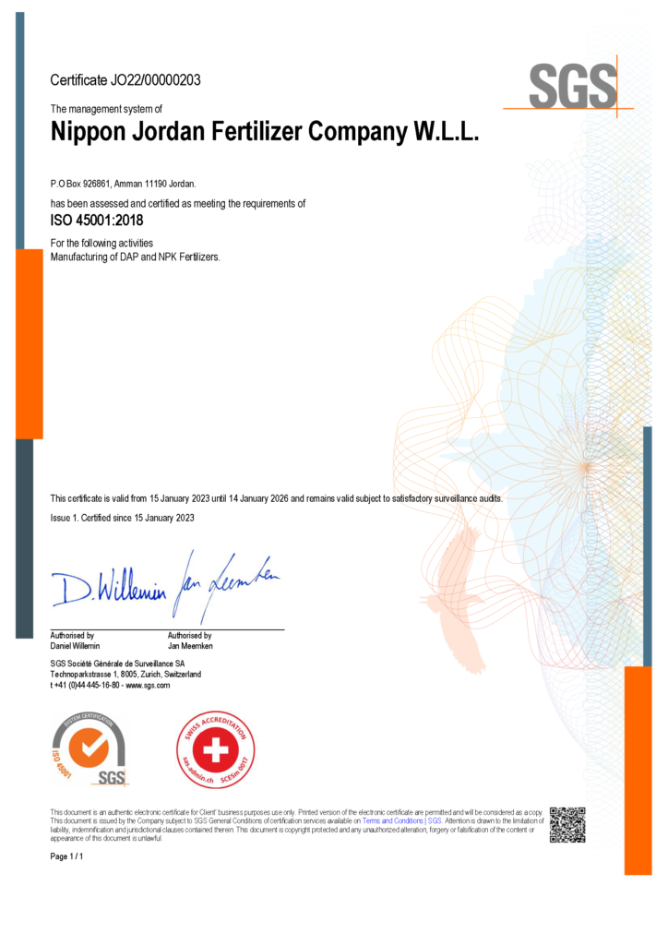
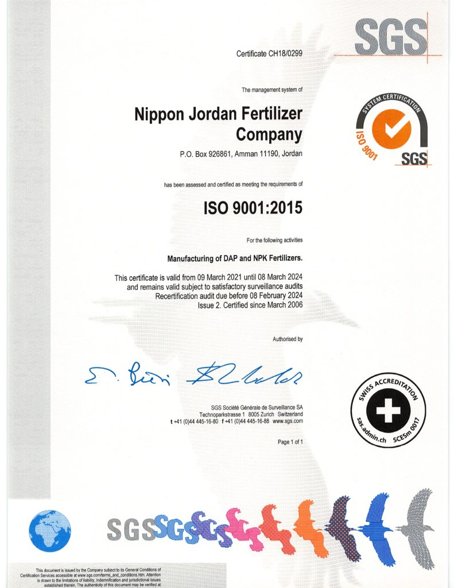
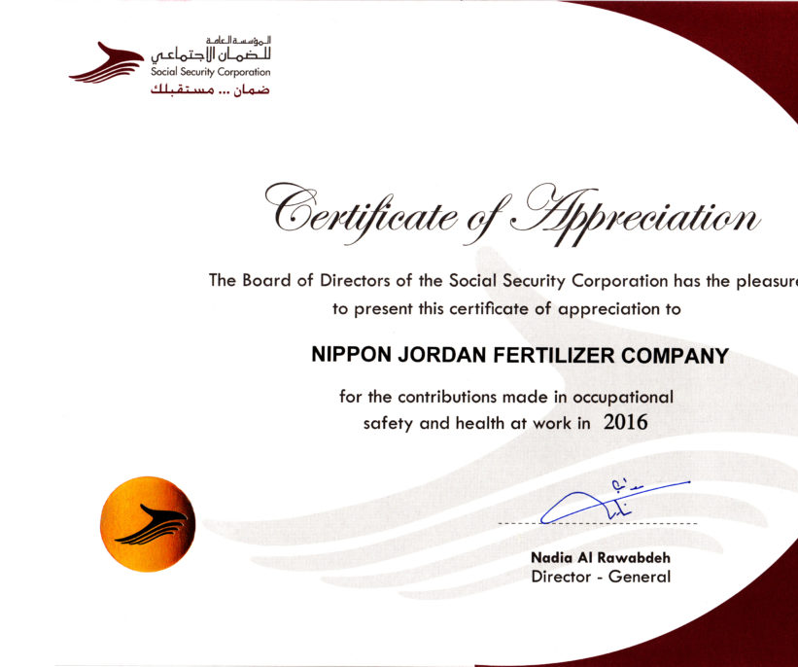
NJFC had been awarded “LEVEL 1 SYSTEM STATUS for Bulk in-Ship Fertilizer and for containerized fertilizer” by Australian Government/Department of Agriculture according to Australian Quarantine and Inspection Services “ AQIS” requirements .
REACH Registration for All NJFC Products (DAP/MAP/NPS/NPK) had been completed which enable NJFC to export these products to European Union countries.

Slide 26
Opportunities for Jordan’s Fertilizer Industry
Expansion of Fertilizer and Downstream Production
Increase production capacity for phosphoric acid, DAP, MAP, and NPK.
Diversify product portfolio by introducing advanced and specialty fertilizers such as:
  TSP, SSP, Technical MAP, Technical MKP
  Water-soluble NPK, Slow-release NPK
Jordan has large reserves, skilled workers, and strategic vision, which support industry growth.
2. Strategic Partnerships and joint ventures
Build on existing partnerships (e.g., with Indonesia, India)and Jordan strong international relationships to form new joint ventures.
These partnerships offer access to capital, advanced technologies, and new markets.

Slide 27
3. Infrastructure and Logistics Development
Upgrade Aqaba Port to enhance export capacity and reduce shipping times.
Improve rail connectivity between mines and port to streamline logistics and reduce transportation costs.
4. Technological Advancement
Modernize mining and fertilizer production to increase efficiency and lower operational costs.
Invest in low-carbon technologies and sustainable fertilizer solutions to align with global environmental trends.
5. Environmental and Water Sustainability
Implement advanced water management techniques, including recycling and saline water desalination.
Following environmental and social standards (ESG) can attract green funding and meet the requirements of environmentally conscious markets.

Slide 28
THANK YOU

